Slide 1
Artificial Intelligence
A Presentation By:
Daniel Breneman
Sean Cox
Robert McConnell
Brian Santo-Domingo

Slide 2
Questions
What is artificial intelligence?
How does it affect humanity?
What can we do about it?

Slide 3

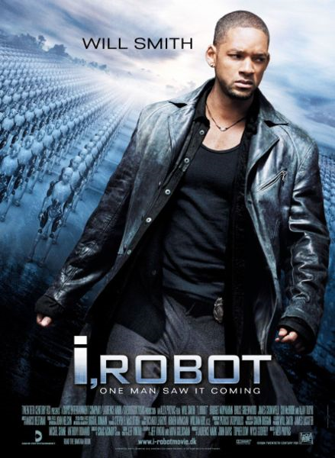
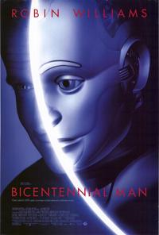
Media
Portrays AI as
Villains
Subjugators
Human

Slide 4
Definition
AI (modern)
AGI
Friendly AI

Slide 5
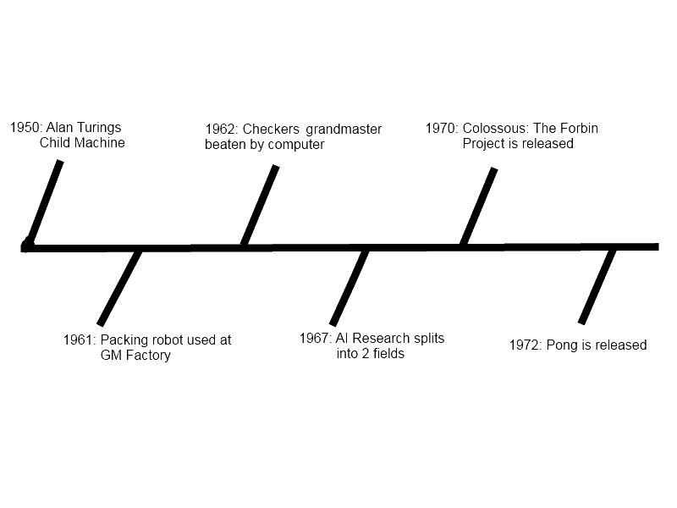
Timeline

Slide 6
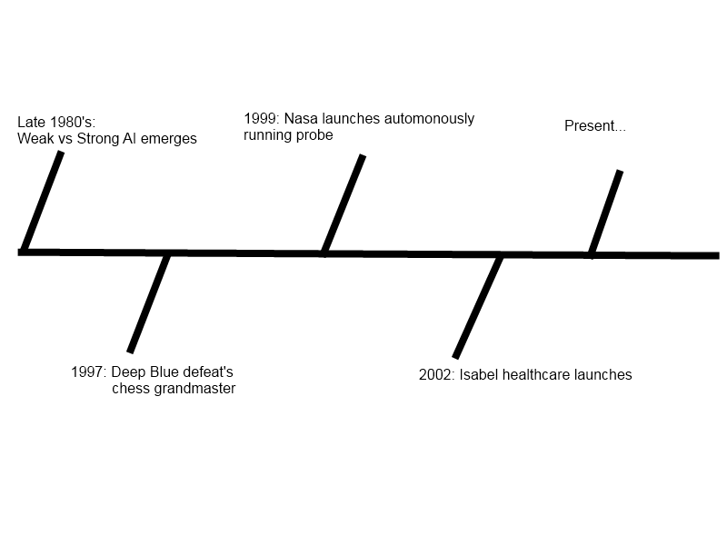
Timeline (cont)

Slide 7
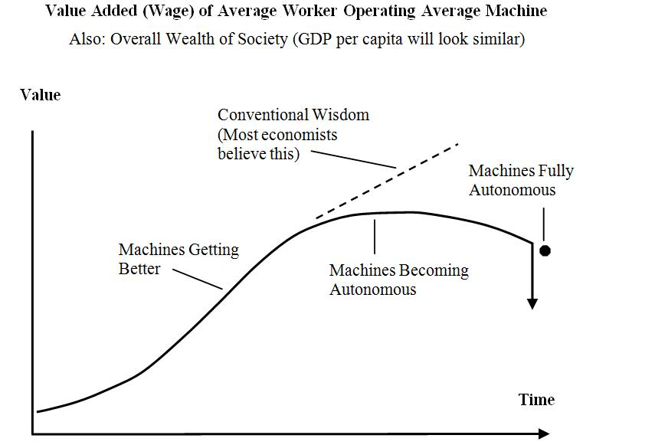
Economics
Automotive
Shipping
Agriculture
Notes:
Discussed the fact of lack of numbers in automotives, well aware it’s a hole in our research. Attempting to fix ASAP

Slide 8
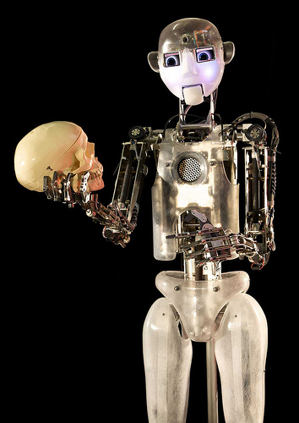
Philosophy
All about asking questions, and putting them in context
After asking questions, ask how they reflect upon yourself
Philosophy asks whether something is true.
Notes:
1st point; important questions in AI: can a machine feel? does it have a soul?
3rd point; exposit on difference between philosophy and ethics (ethics asks what it means *if* something is true)

Slide 9
Common Philosophical Questions
Can a machine feel emotions?
Does an AI have a soul?
Is an AI a person?
Notes:
Emotions question: Scherer definition of emotions (reaction to input in context of previous experiences and preferences) & reinforcement learning methods that mimic it.
Soul question: Much, much more abstract, reflect mostly on wobbly definition of a soul to begin with. Say that we're not even sure if *we* have a soul. Maybe mention idea of 'ghost in a shell' style constructs.
Person question: Related to soul question, but has more legal ramifications. Maybe talk a little about ttp://www.physorg.com/news185729677.html

Slide 10
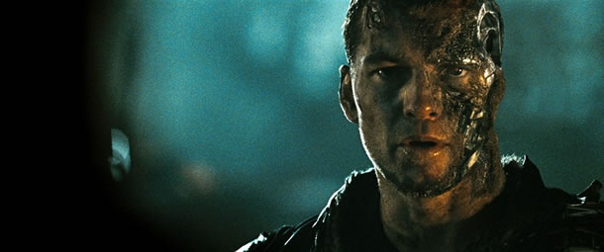
Ethics
What is truly right? For humans? For robots?
Asimov’s Three Sets of Robotic Laws (Runaround)
Replacing humans with robots
Capable of so much, but to what extent?
“We have hundreds of examples today of Narrow AI… and the narrowness is gradually getting less narrow”
Kurzweil’s “Merging with the Machines”
Sam Worthington as Marcus Wright,
Terminator Salvation
Notes:
Refer to Asimov’s Three Sets of Robotic Laws, Runaround = Short story introduced by Asimov about a space trip to Mercury involving the use of
A robot may not injure a human being, or, through inaction, allow a human being to come to harm.
A robot must obey orders given it by human beings except where such orders would conflict with the First Law.
A robot must protect its own existence as long as such protection does not conflict with the First or Second Law. (I, Robot,6)

Slide 11
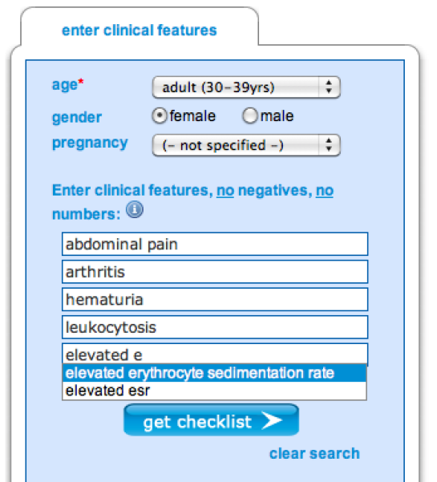
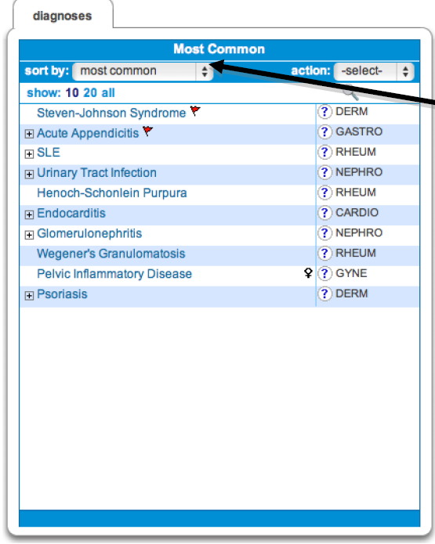
Culture
Idea of helping mankind with AI has been around since 1988
Intelligent knowledge gatherer systems such as Isabel help doctors make the tougher decisions in their career

Slide 12
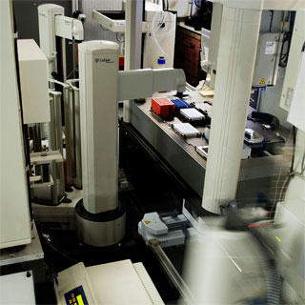
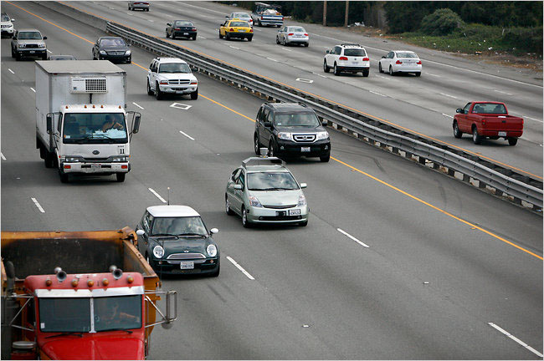
Culture (cont)
Adam utilizes robotics and a unique research intelligence to create, test and document biological experiments
DARPA has been funding the creation of self driving cars, some of which are in our very area.

Slide 14
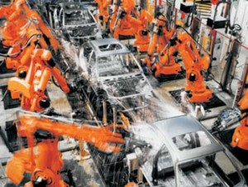
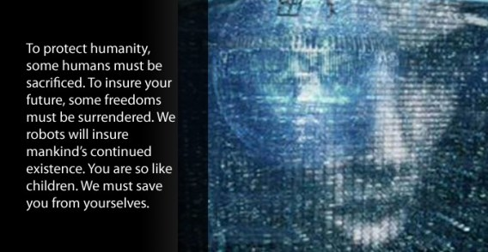
Problems
Job outlook
Rogue AI
Notes:
-Viki Picture : http://getdclu.wordpress.com/2009/08/25/making-and-controlling-a-robotic-public/
- Assembly Line : http://robotsftw.com/2009/08/so-are-robots-stealing-our-jobs/

Slide 15
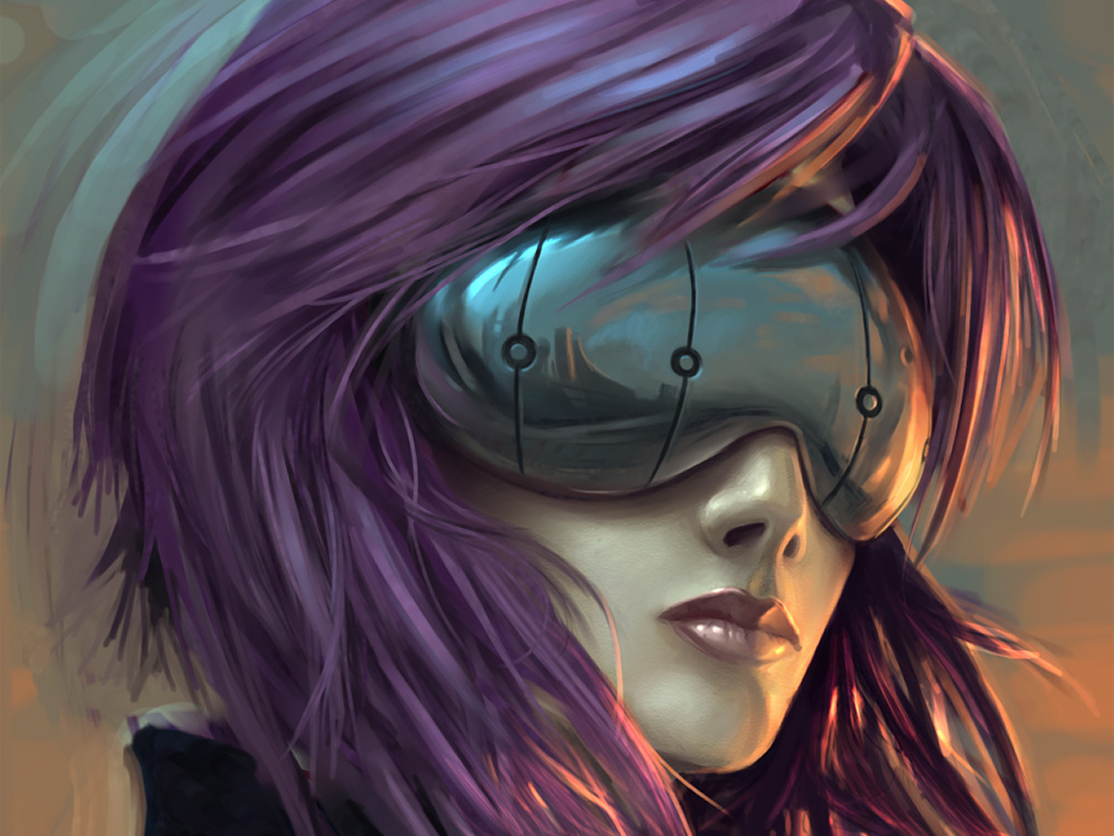
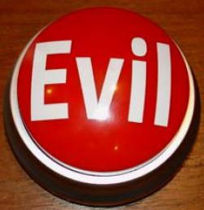
Solutions
Advance humanity
Say no to the red button

Slide 16
Conclusion
What is artificial intelligence?
How does it affect humanity?
What can we do about it?

Slide 18
References
Economics Image: http://warning.zoned.dk/

